Slide 1
Automatic
Fan Control System
Guided By: Prof. Somnath Lomate
Group Members: Aadarsh Jadhav
Rohit Kulkarni

Slide 2
What does it do? And why do you need it?
Senses the temperature
Adjusts the fan’s speed depending upon speed
One less concern from your mind
Optimized fan performance

Slide 3
How does it work?
Senses the room temperature
Sends data to Arduino
Arduino processes the data
Decides to increase the speed or not
Recorded temperature sent to LCD

Slide 4
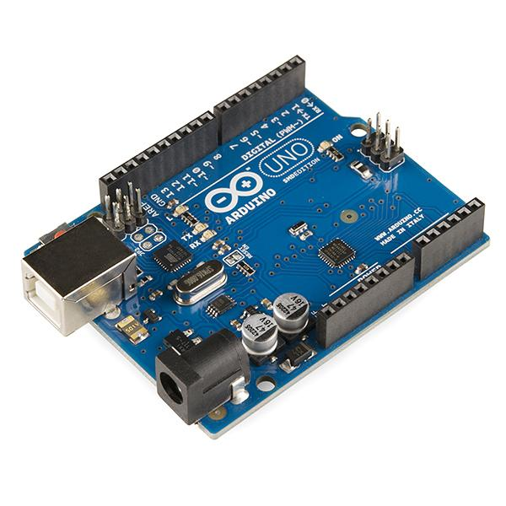
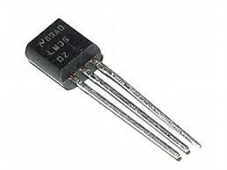
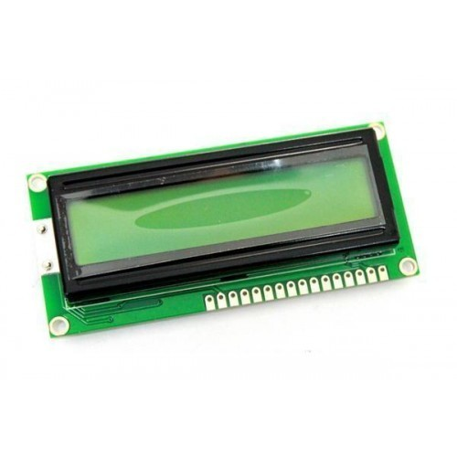
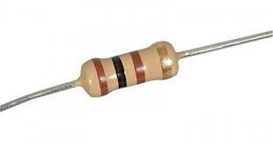
Hardware requirements
Arduino Uno
LM35
LCD
Breadboard
DC motor
Resistor

Slide 5
Advantages and Disadvantages
Advantages:
Electricity savings
No control adjustments
Disadvantages:
Not aware of human condition or mood
Not aware of warm food etc

Slide 6

What’s the future?
Fully automated home system
Automated Air Conditioner

Slide 7
Thank You!

